Slide 1

Biostats Boot Camp – Session 1
F. Perry Wilson
Aditya Biswas

Slide 2
Who we are
F. Perry Wilson, MD MSCE
-Director of CTRA
-Nephrologist
-Here for the intuition
Aditya Biswas, MS
-Data scientist
-Machine-learning guru
-Here for the implementation

Slide 3
Overview
Major Goal: By the end of the bootcamp, you should be able to take a dataset, make basic analyses of the data, perform simply hypothesis testing and regressions, and create figures that accurately represent and communicate the underlying data\
Assumptions: No biostats experience, no R experience, no programming experience

Slide 4
Session breakdown
Orient to R/Rstudio – basic commands, how variables work, fundamentals of programming
Initial analysis of a dataset, Exploration of probability
Hypothesis testing
Adjustment and estimation

Slide 5
Orienting to RStudio
Left Top – Editor, Variable Explorer
Left Bottom – Console Window
Right Top – Environment, History
Right Bottom – Plots, Help

Slide 6
Variables
Creation
Reuse
Deletion

Slide 7
Exercise #1
Create a variable named biostats.class which has the value 60
Print that variable
Remove it

Slide 8
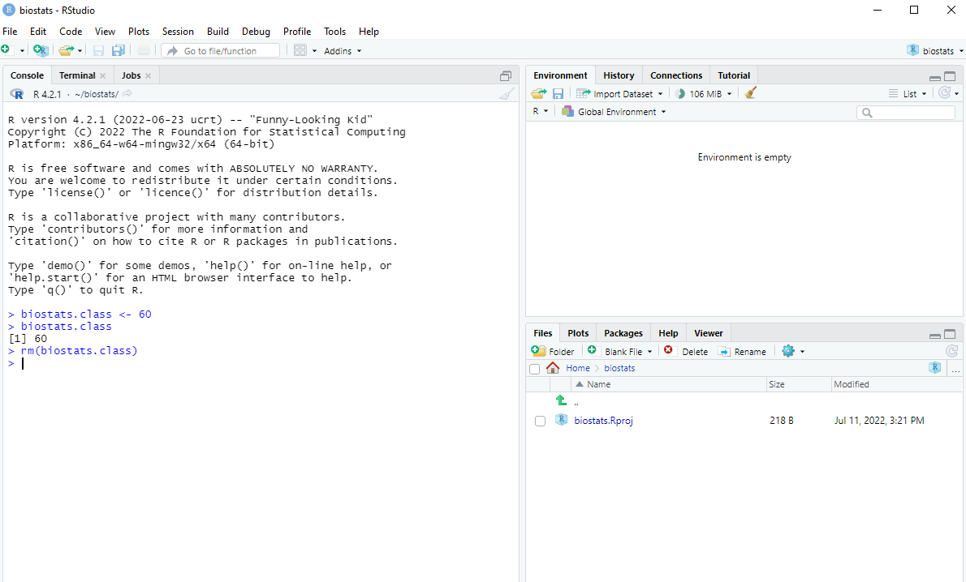

Slide 9
Basic Data Types
Logicals
Numerics
Integers
Characters
Dates (sort of)

Slide 10
Exercise #2
Create an integer variable called pints.of.beer equal to 8.
Confirm that the new variable is indeed an integer
Confirm whether the new variable is also numeric
Confirm whether the new variable is also character

Slide 11
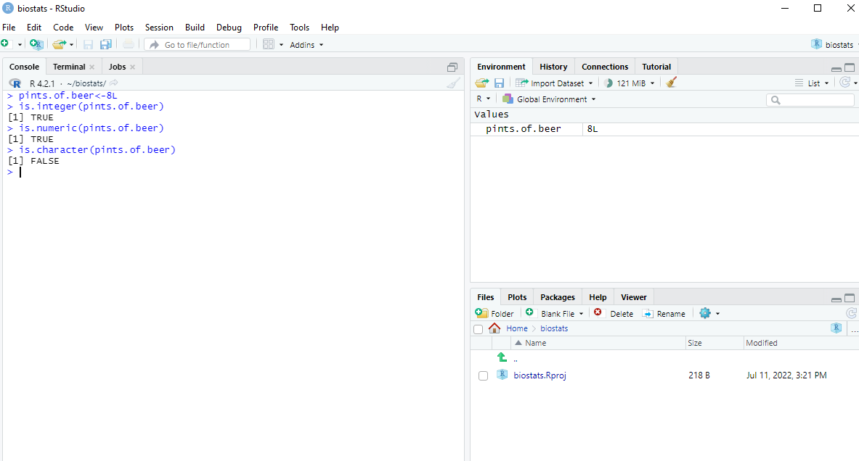

Slide 12
Exercise #3
Create a variable called date_of_birth equal to December 5th, 1979
Is this new variable an integer?
Is it numeric?
Is it character?
How can you tell what class it is?

Slide 13
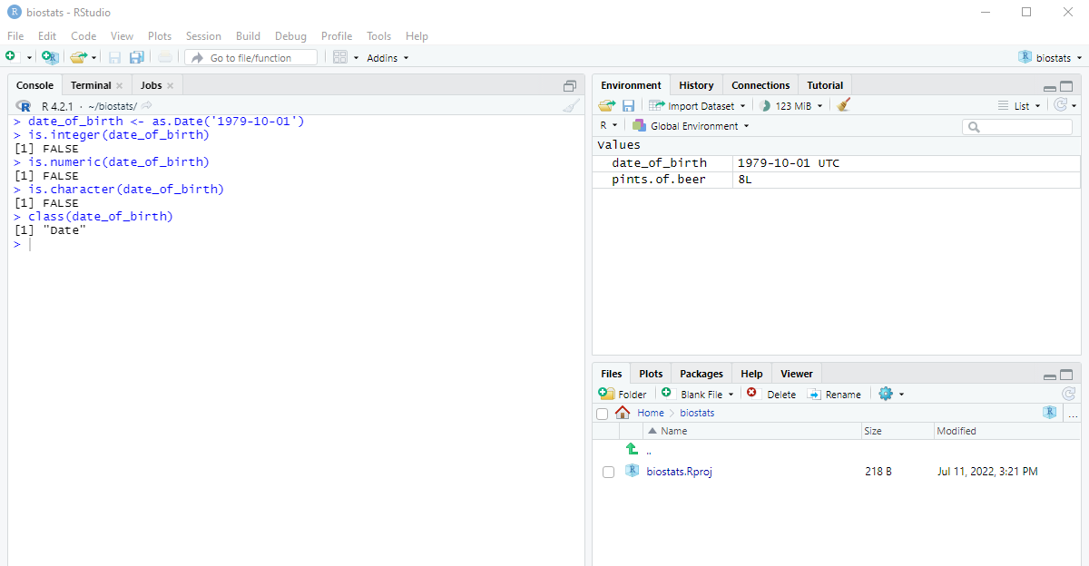

Slide 14
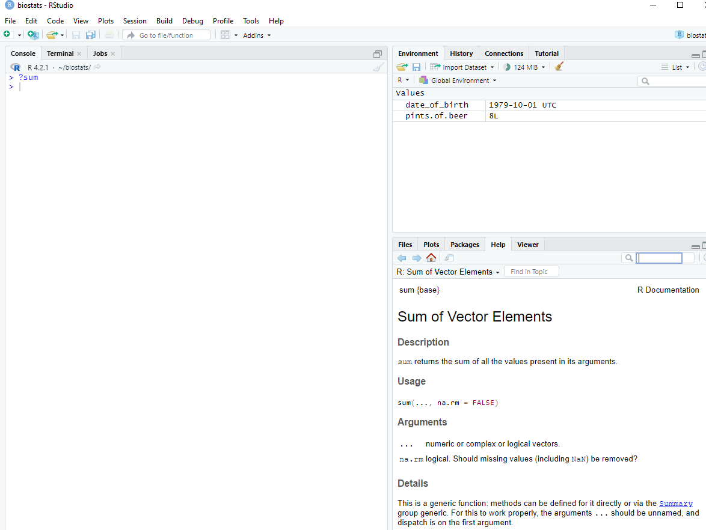
Functions

Slide 15
Exercise #4
What is the sum of 10, 20, 30, 40, and 50?
What is the sum of 10, 20, 30, 40, 50, and NaN?
What is the sum of 10, 20, 30, 40, 50, and NaN if you allow R to ignore NaN?

Slide 16
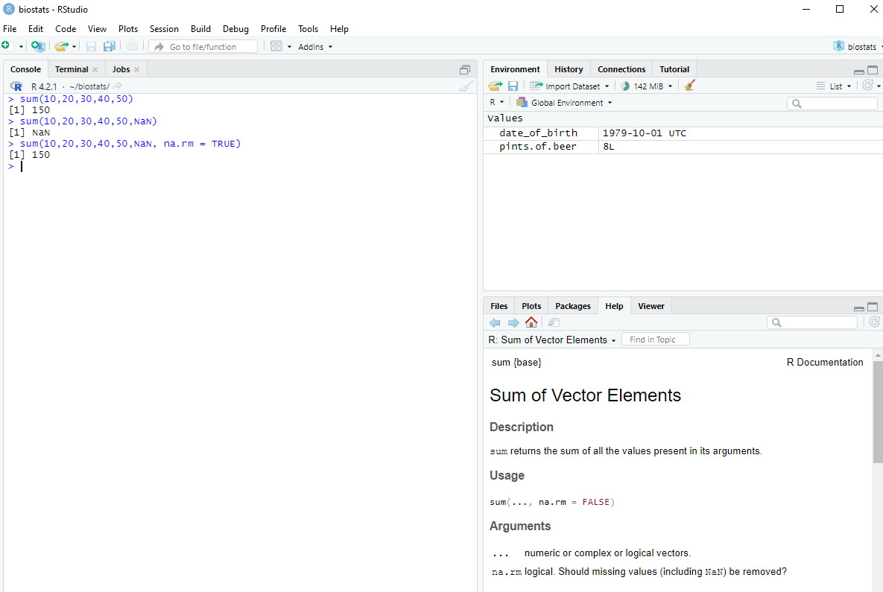

Slide 17
Logical Operations

Slide 18
Exercise #5
Create a variable called creatinine equal to 5.5
Create a variable called potassium equal to 7.2
(You should probably call a nephrologist)
Create a variable called ouch that will be true if potassium is greater than creatinine
Display that variable

Slide 19
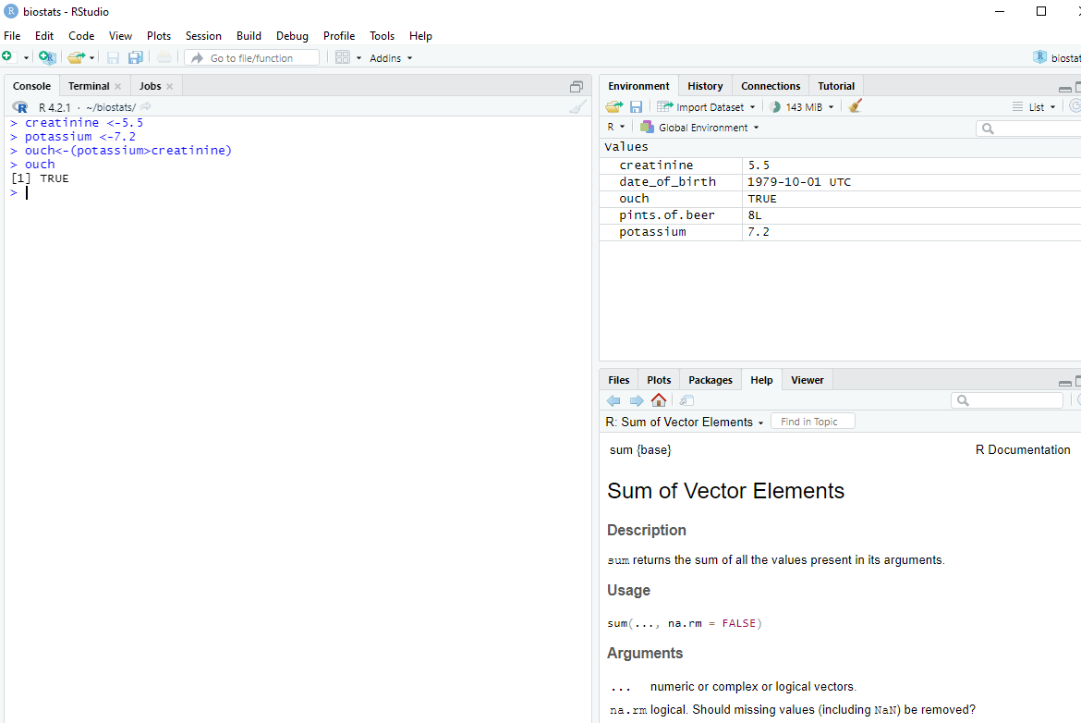

Slide 20
Data Structures
Vectors
Lists
Data Frames

Slide 21
Exercise #6
Create a vector called income with the following values: 100, 200, 1000, sixty
Remember to guard your strings
What class does this vector take?

Slide 22
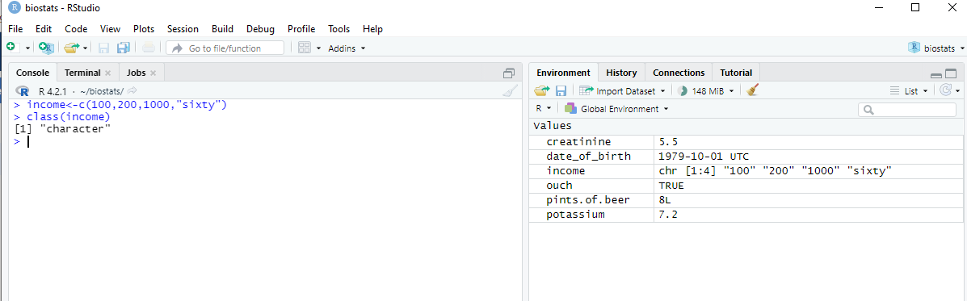

Slide 23
Exercise #7
Create a vector called days which count from 2 to 30 by 3s
Create a vector called song which repeats “dum”, “dee”, “doo” 6 times

Slide 24
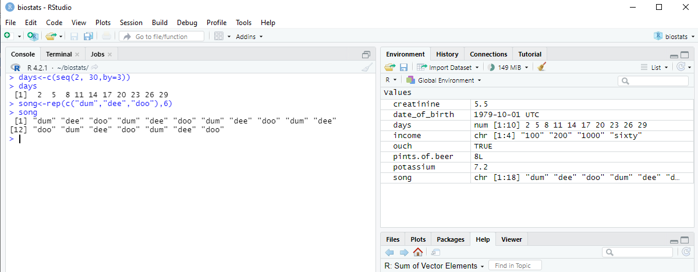

Slide 25
Sorting

Slide 26
Exercise #8
Create a vector called pie with values: 3,1,4,1,5,9,2,6,5,3
Sort it in ascending order
Sort it in descending order

Slide 27
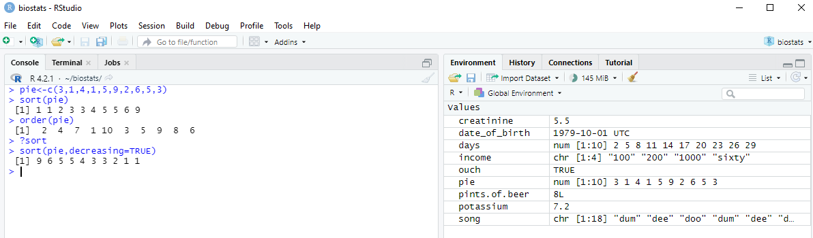

Slide 28
Exercise #9
Create a vector called age that captures this information:
Display Aragorn’s age
Person | Age
Frodo | 50
Gandalf | 2000
Aragorn | 87
Galadriel | 8374
Pippin | 28

Slide 29
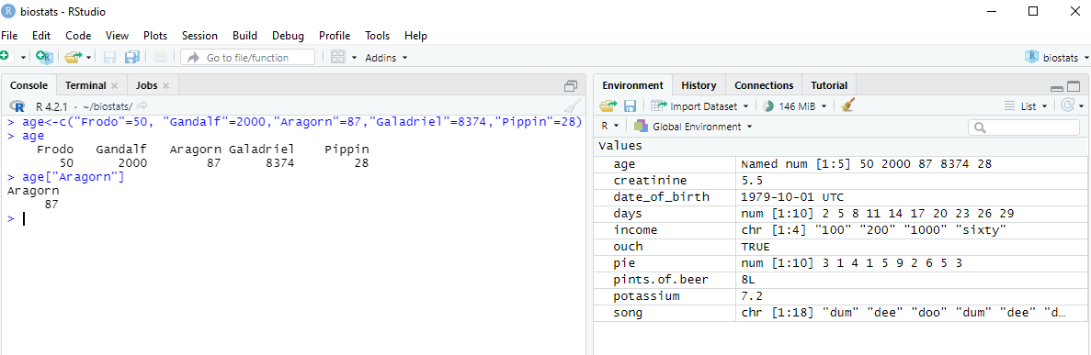

Slide 30
Exercise #10
Data entry error! Frodo is actually 55. Update this datapoint.
Let’s figure out how old everyone would be if they were alive today. Add 8000 to each age.

Slide 31
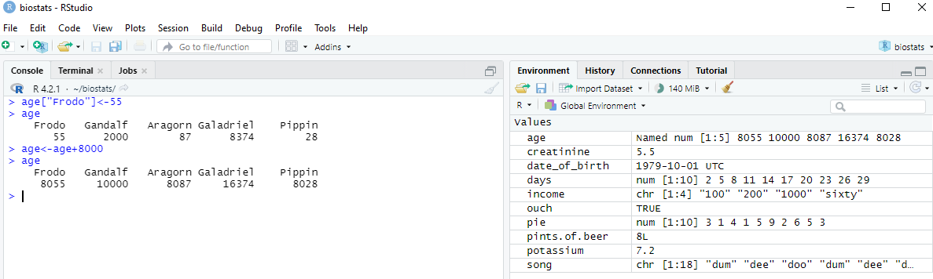

Slide 32
Factor Data (Critical in Medicine!)

Slide 33
Exercise #11
Create a variable called "race" that has the following values: hobbit, maiar, human, elf, hobbit

Slide 34
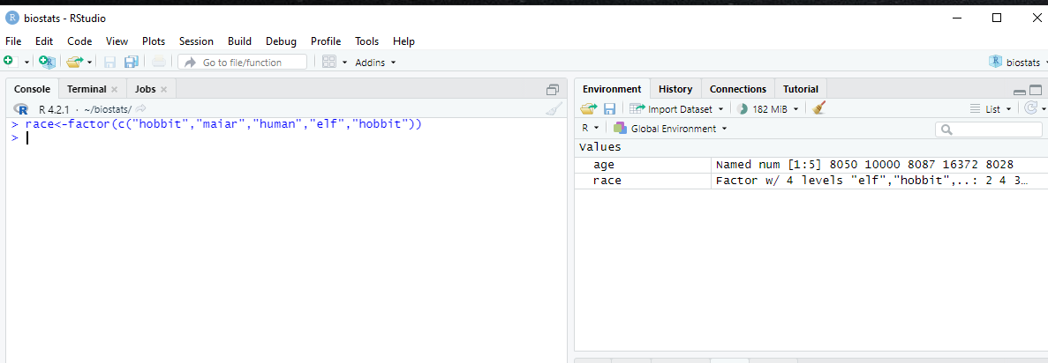

Slide 35
Data Frames

Slide 36
Exercise #12
Create a data frame called mid.earth that combines the age and race vectors
Display the data for individuals who are >9999 years old

Slide 37
